Slide 1
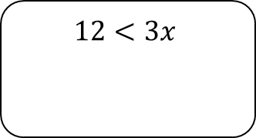
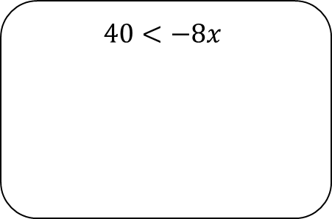
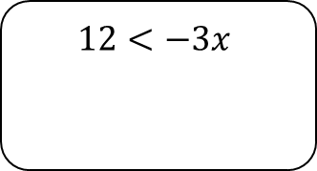
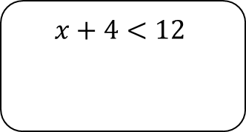
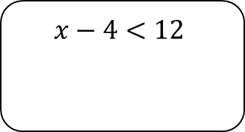
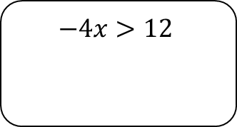
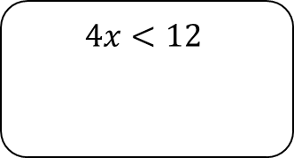

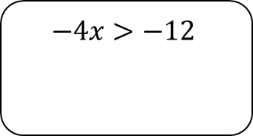
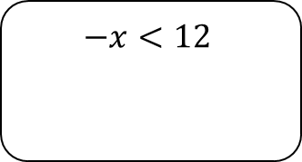
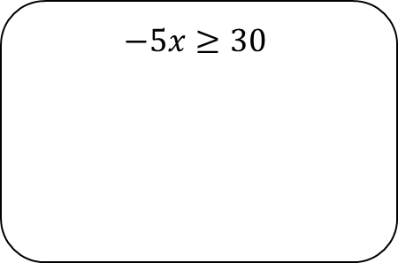
Manipulating Inequalities
For each of the following decide if the student has written a correct step or an incorrect step
$$4x<12$$
$$−4x<12$$
$$−x<12$$
$$12<−3x$$
$$x+4<12$$
$$12<3x$$
$$−4x>12$$
$$x−4<12$$
$$−4x>−12$$
Now solve these inequalities
$$−5x≥30$$
$$40<−8x$$

