Slide 1
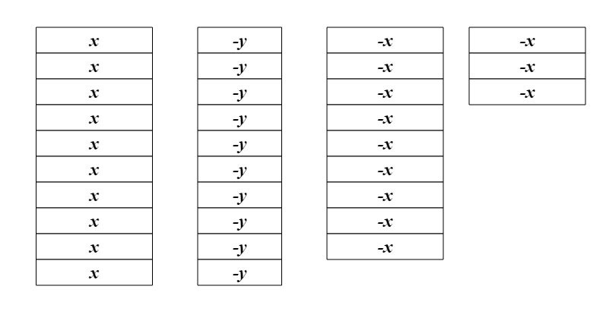
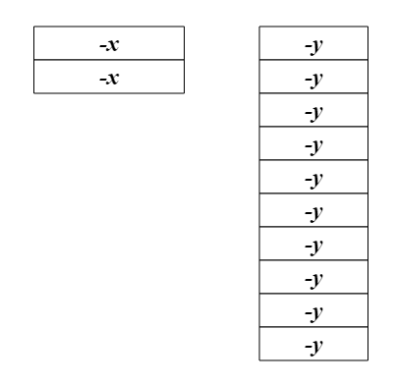
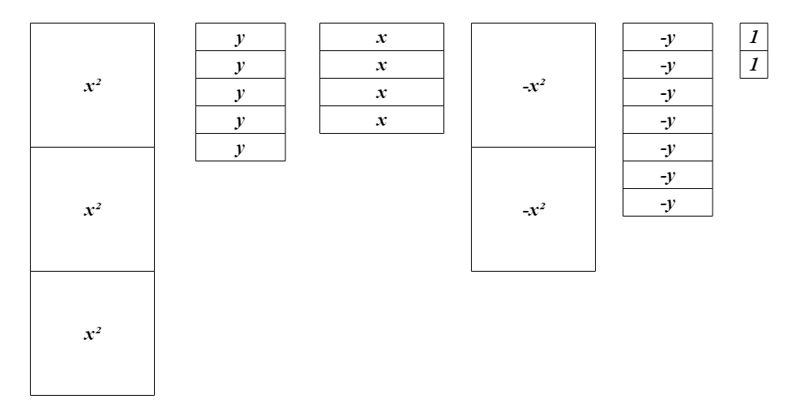
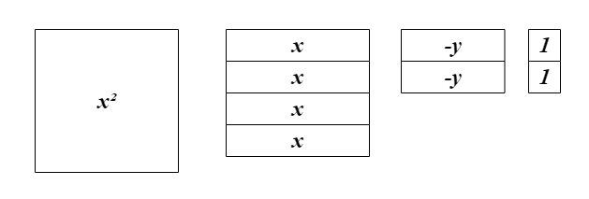
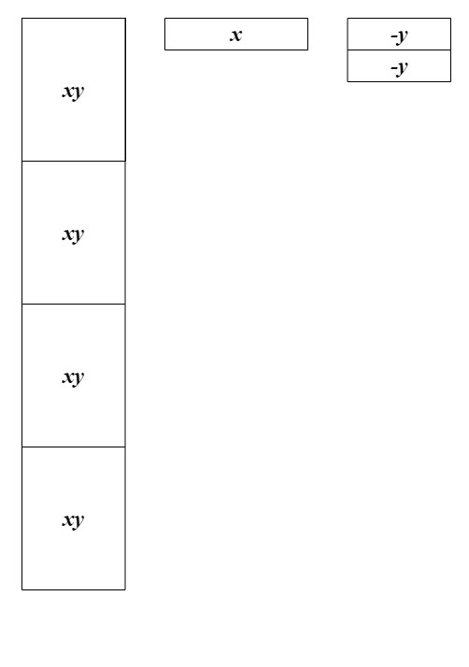
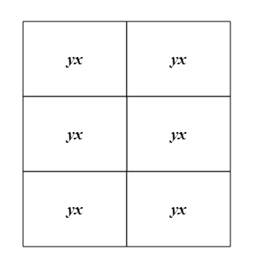
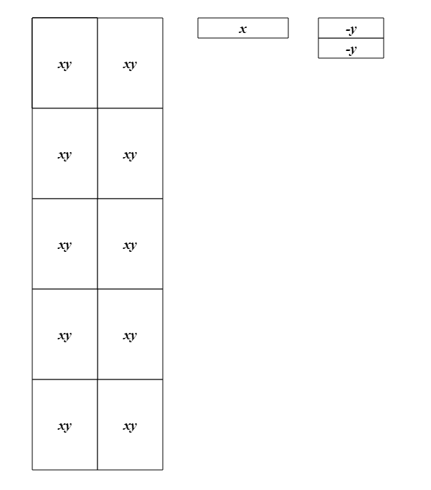
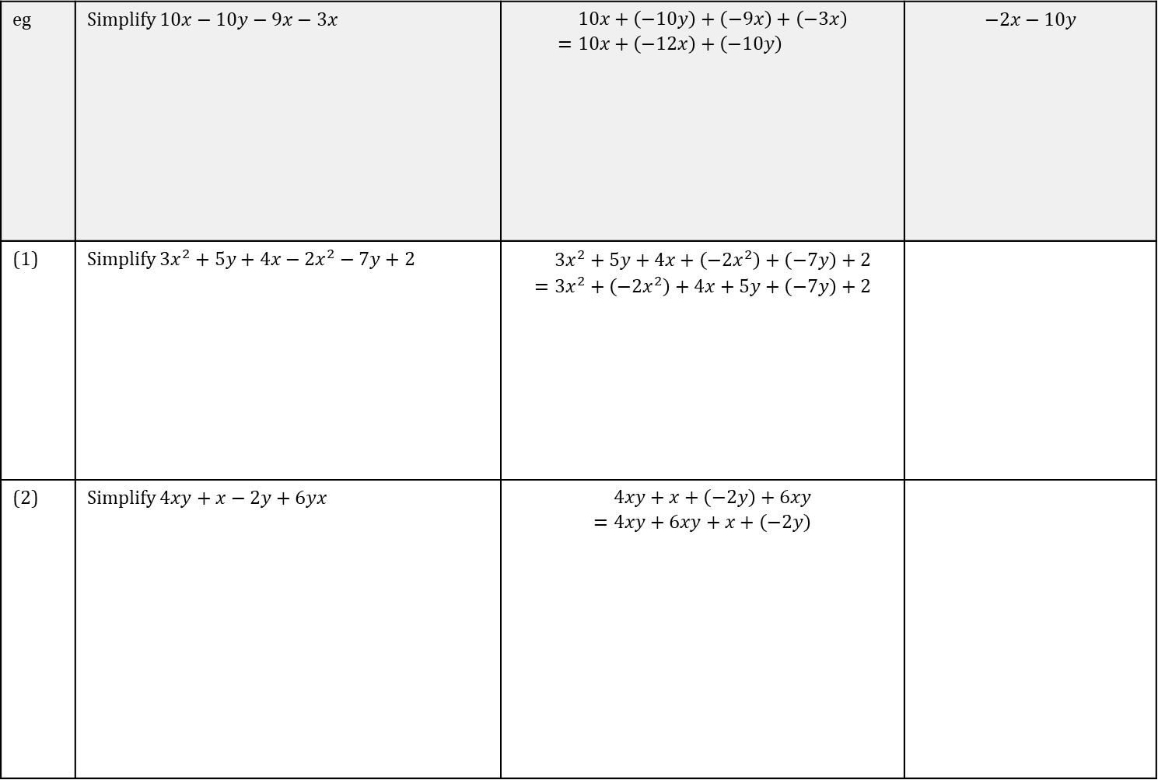
TASK
Collecting like terms (1/2)
Date:
eg | Simplify $10x−10y−9x−3x$ | $$\begin{aligned}&10x+\left(−10y\right)+\left(−9x\right)+\left(−3x\right) \\ =&10x+\left(−12x\right)+\left(−10y\right)\end{aligned}$$ | $$−2x−10y$$
(1) | Simplify $3x^{2}+5y+4x−2x^{2}−7y+2$ | $$\begin{aligned}&3x^{2}+5y+4x+\left(−2x^{2}\right)+\left(−7y\right)+2 \\ =&3x^{2}+\left(−2x^{2}\right)+4x+5y+\left(−7y\right)+2\end{aligned}$$
(2) | Simplify $4xy+x−2y+6yx$ | $$\begin{aligned}&4xy+x+\left(−2y\right)+6xy \\ =&4xy+6xy+x+\left(−2y\right)\end{aligned}$$

Slide 2
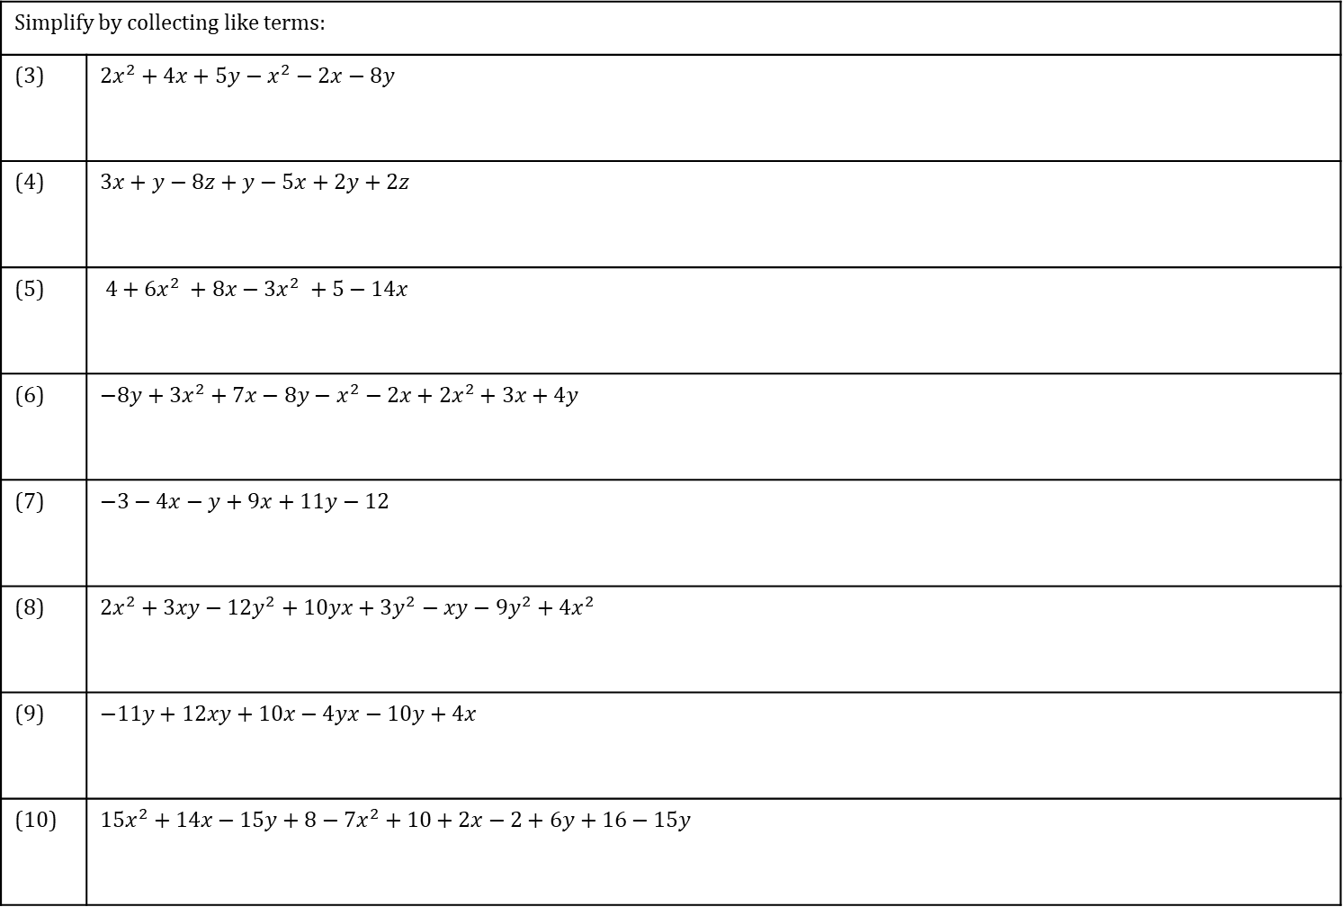
TASK
Collecting like terms (2/2)
Date:
Simplify by collecting like terms:
(3) | $2x^{2}+4x+5y−x^{2}−2x−8y$
(4) | $3x+y−8z+y−5x+2y+2z$
(5) | $4+6x^{2} +8x−3x^{2} +5−14x$
(6) | $−8y+3x^{2}+7x−8y−x^{2}−2x+2x^{2}+3x+4y$
(7) | $−3−4x−y+9x+11y−12$
(8) | $2x^{2}+3xy−12y^{2}+10yx+3y^{2}−xy−9y^{2}+4x^{2}$
(9) | $−11y+12xy+10x−4yx−10y+4x$
(10) | $15x^{2}+14x−15y+8−7x^{2}+10+2x−2+6y+16−15y$

Slide 3
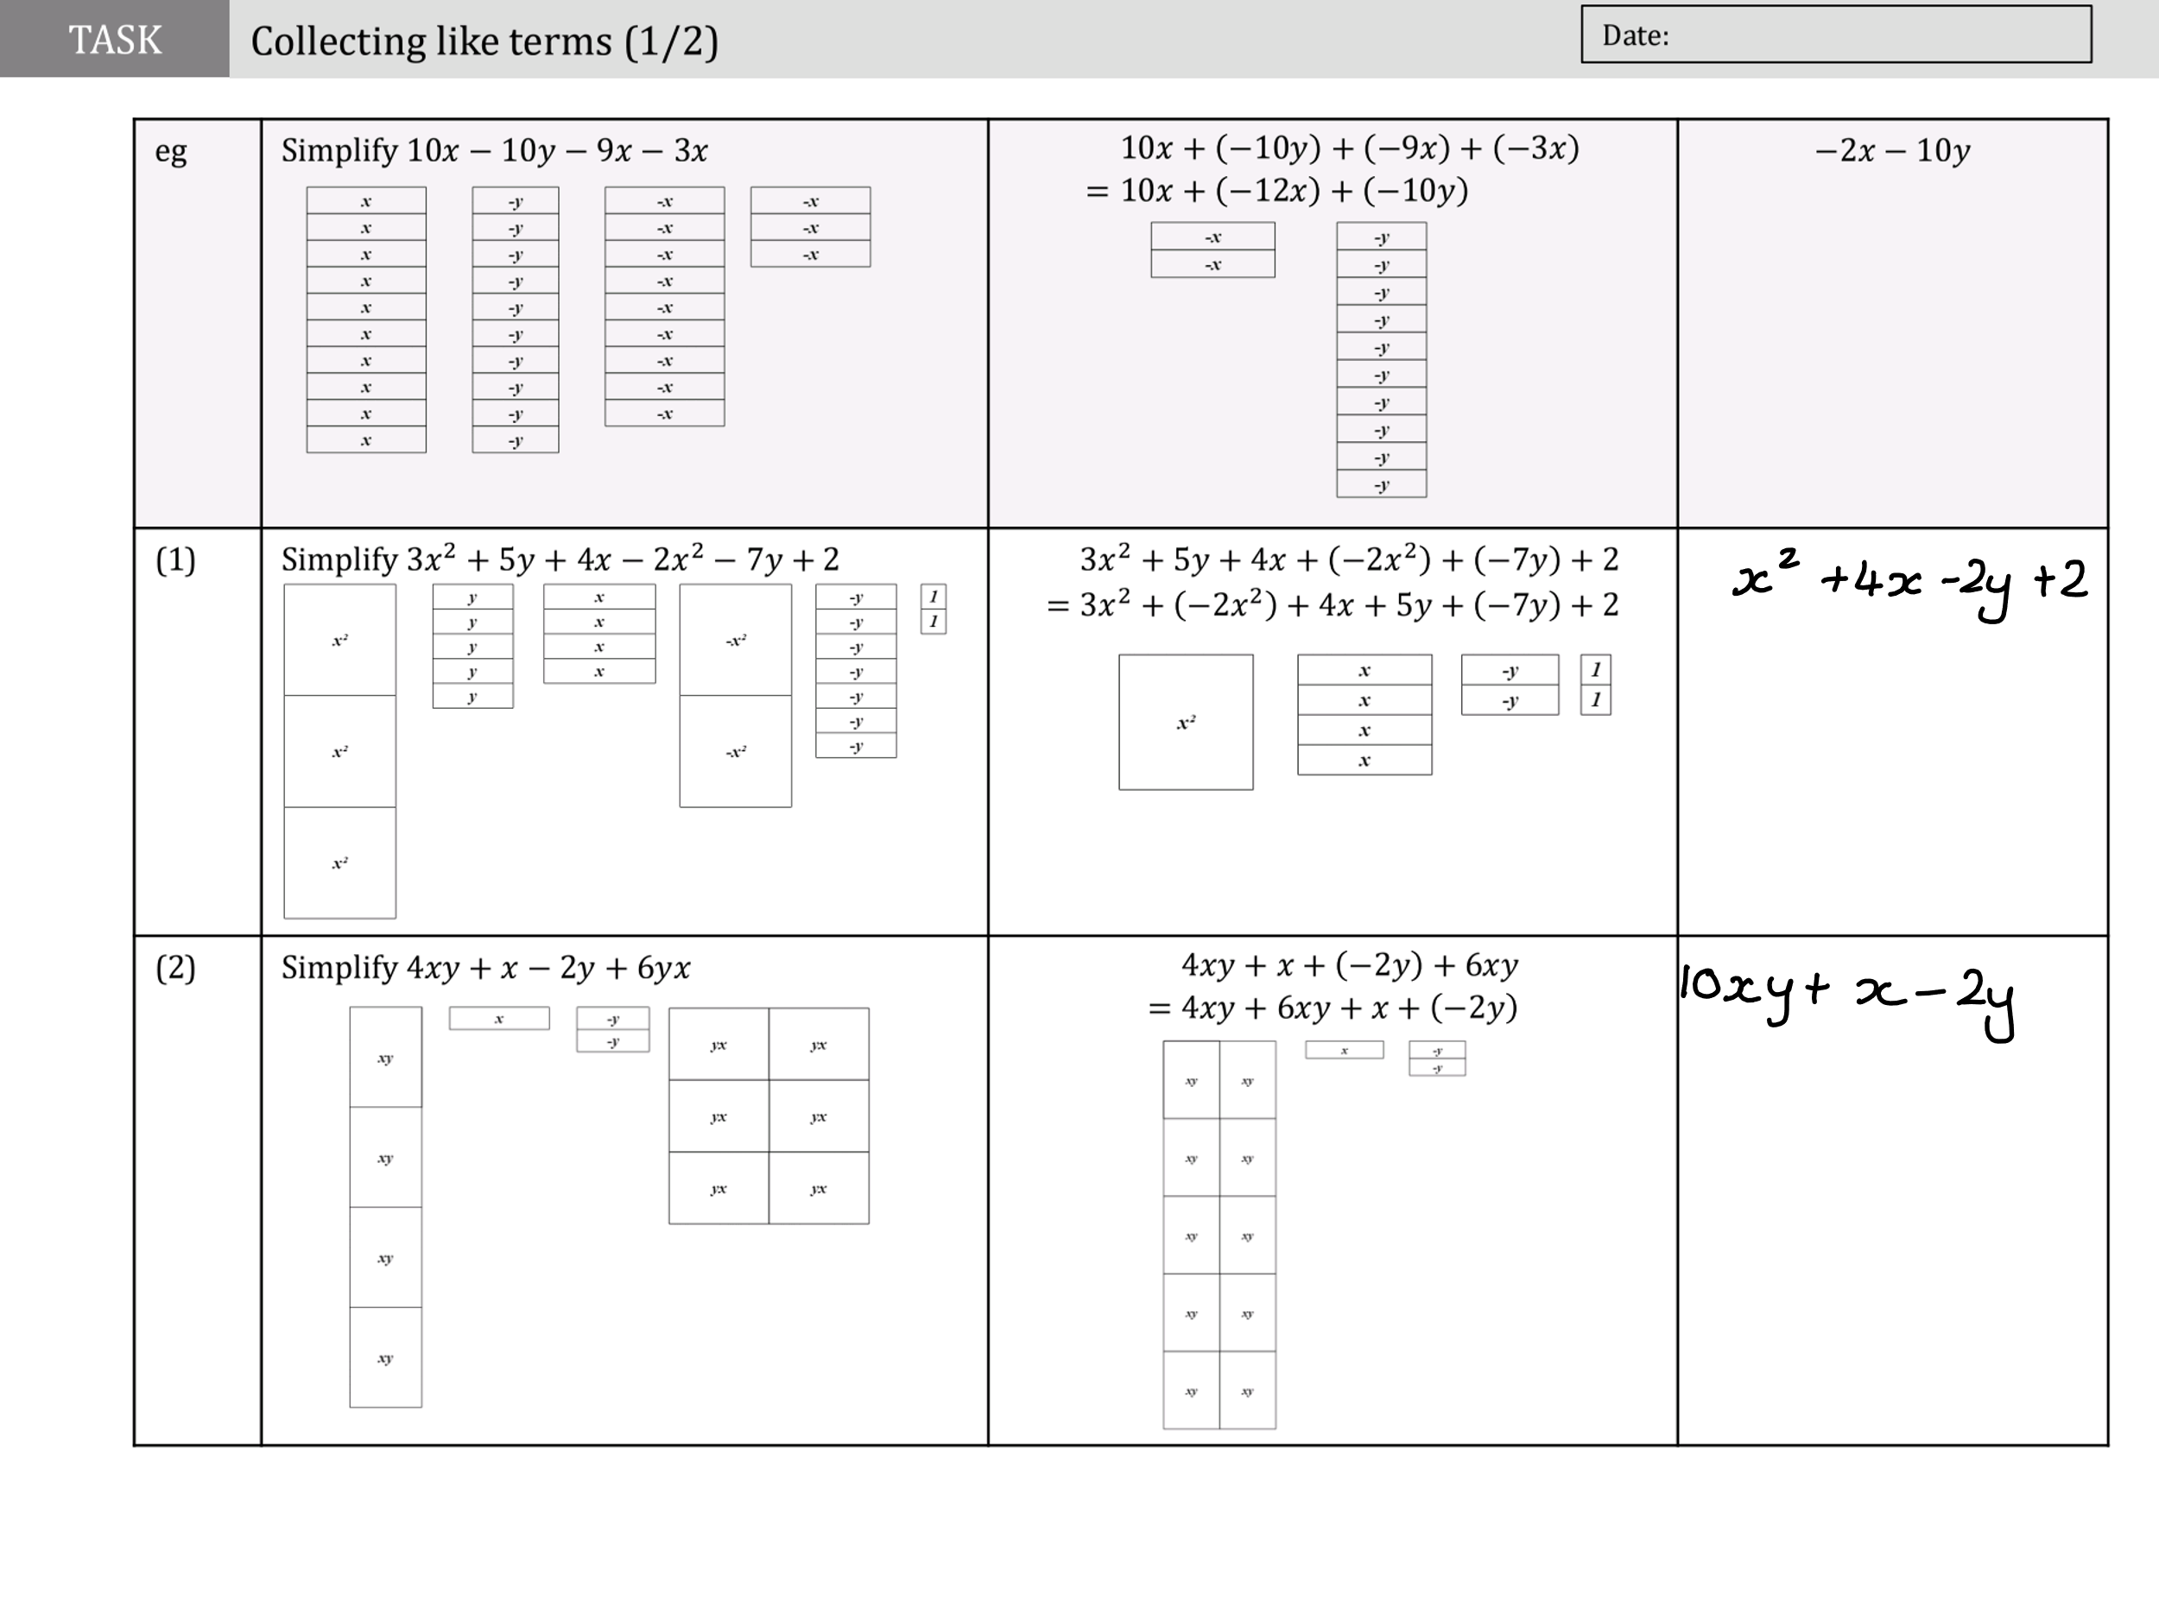

Slide 4
