Slide 1
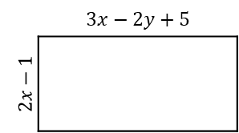
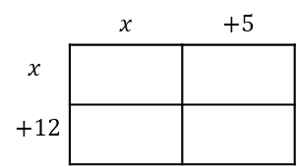
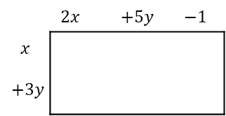
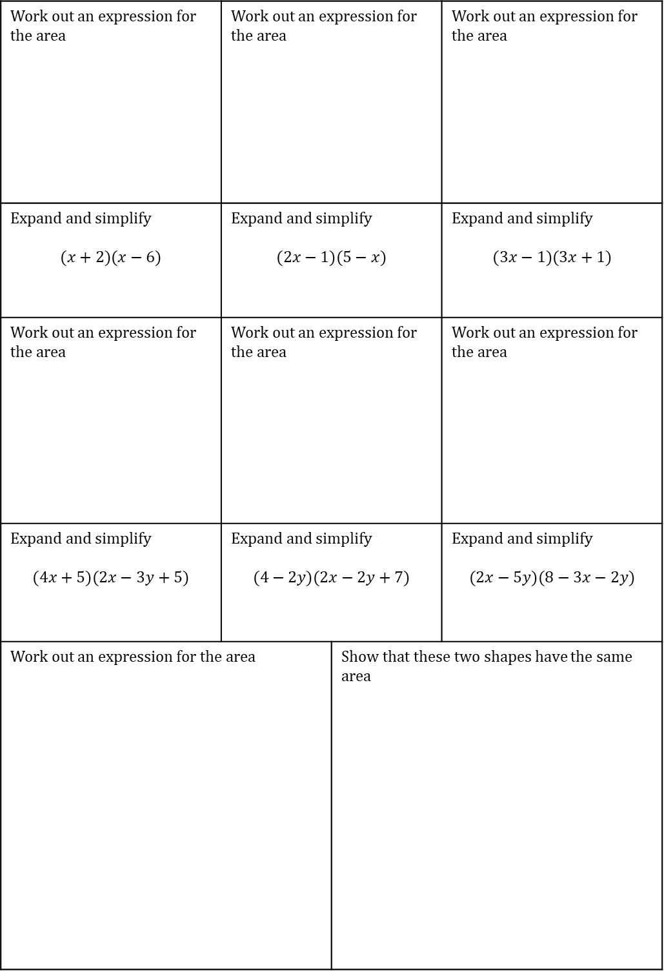
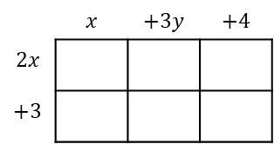
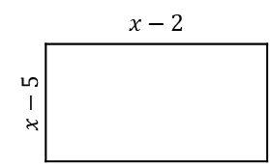
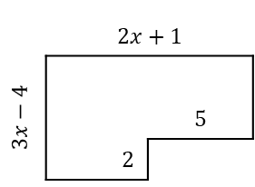
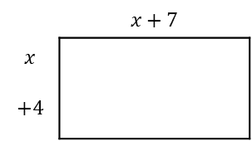
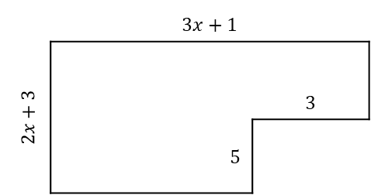
DOUBLE BRACKETS - TASK
Work out an expression for the area | Work out an expression for the area |  | Work out an expression for the area
Expand and simplify $$(x+2)(x−6)$$ | Expand and simplify $$(2x−1)(5−x)$$ |  | Expand and simplify $$(3x−1)(3x+1)$$
Work out an expression for the area | Work out an expression for the area |  | Work out an expression for the area
Expand and simplify $$(4x+5)(2x−3y+5)$$ | Expand and simplify $$(4−2y)(2x−2y+7)$$ |  | Expand and simplify $$(2x−5y)(8−3x−2y)$$
Work out an expression for the area |  | Show that these two shapes have the same area | Work out an expression for the area
 | $$x$$ | $$+5$$
$$x$$
$$+12$$
 | $$x+7$$ | $$+5$$
$$x$$
$$+4$$
 | $$x−2$$ | $$+5$$
$$x−5$$
$$+4$$
 | $$x$$ | $$+3y$$ | $$+4$$
$$2x$$
$$+3$$
 | 2$x$ | $$+5y$$ | $$−1$$
$$x$$
$$+3y$$
 | $$3x−2y+5$$ | $$+5y$$ | $$−1$$
$$2x−1$$
$$+3y$$
 | $$3x+1$$
$$2x+3$$ |  | 3
 | 5
 | $$2x+1$$
$$3x−4$$ |  | 5
 | 2
 | $$6x+7$$ | $$+5$$
$$x−2$$
$$+4$$

