Slide 1
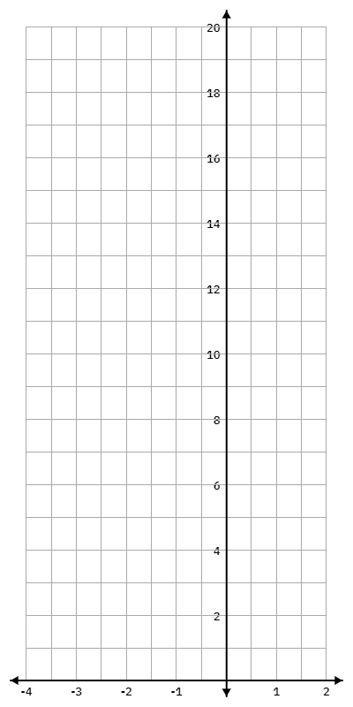

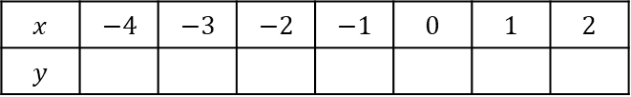
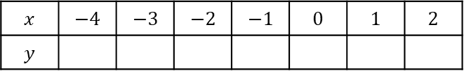
TASK
Sketch the following two graphs and write down their points of intersection
Date:
$$y=x^{2}+2x+10$$
$$x$$ | $$−4$$ | $$−3$$ | $$−2$$ | $$−1$$ | $$0$$ | $$1$$ | $$2$$
$$y$$
$$y=−3x+4$$
$$x$$ | $$−4$$ | $$−3$$ | $$−2$$ | $$−1$$ | $$0$$ | $$1$$ | $$2$$
$$y$$

Slide 2

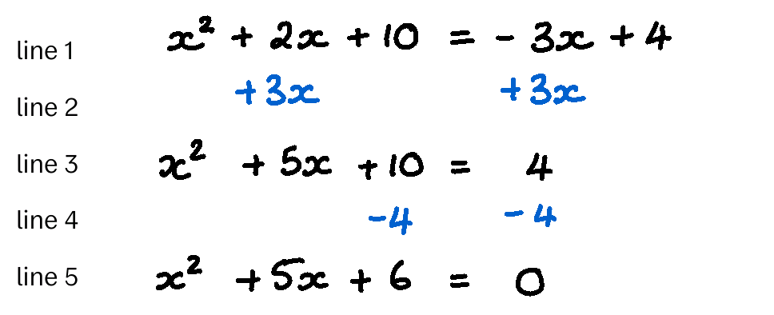

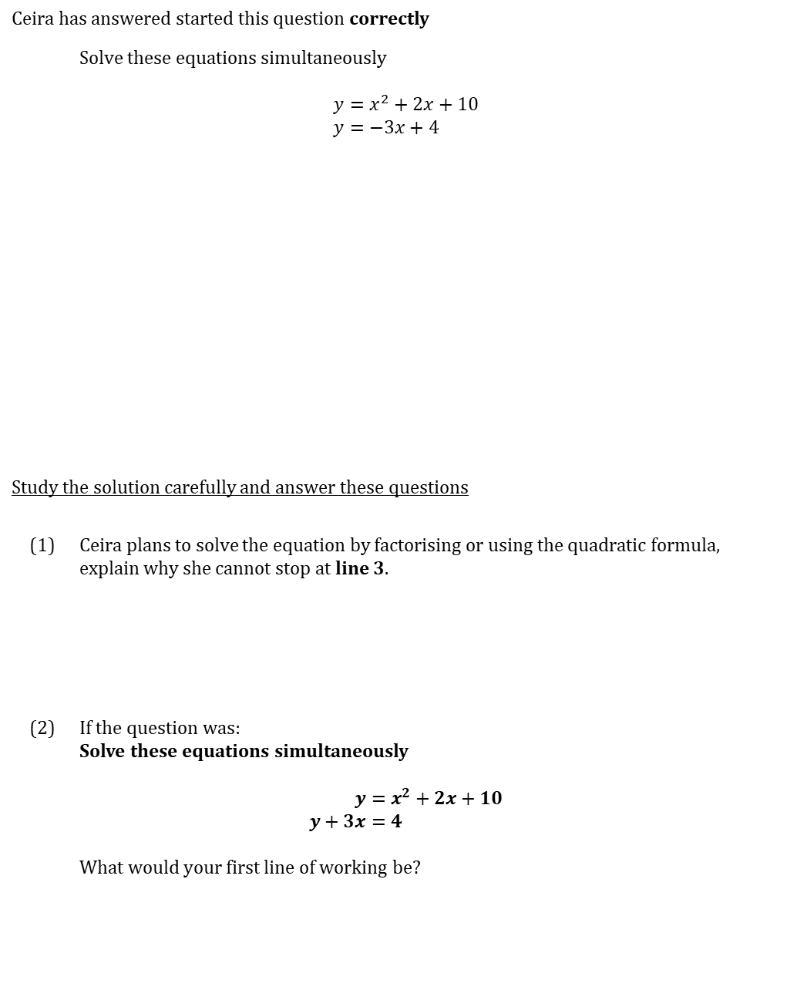
WORKED EXAMPLE
Solving algebraically
Date:
Ceira has answered started this question correctly
 | Solve these equations simultaneously $$y=x^{2}+2x+10 \\ y=−3x+4$$
Study the solution carefully and answer these questions
(1) | Ceira plans to solve the equation by factorising or using the quadratic formula, explain why she cannot stop at line 3.
(2) | If the question was: Solve these equations simultaneously $$\begin{aligned}y&=x^{2}+2x+10 \\ y+3x&=4\end{aligned}$$ What would your first line of working be?

Slide 3
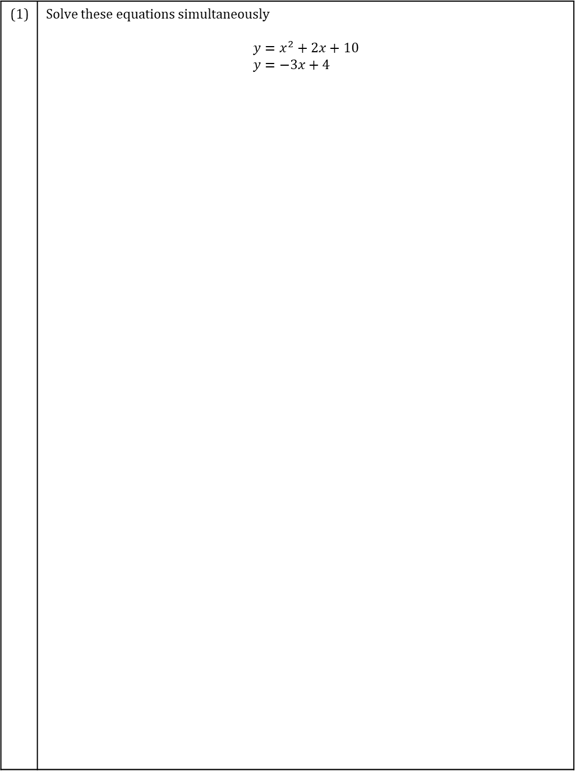
TASK
Solving simultaneous equations
Date:
Complete these questions
(1) | Solve these equations simultaneously $$y=x^{2}+2x+10 \\ y=−3x+4$$

Slide 4
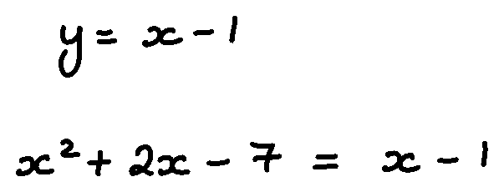
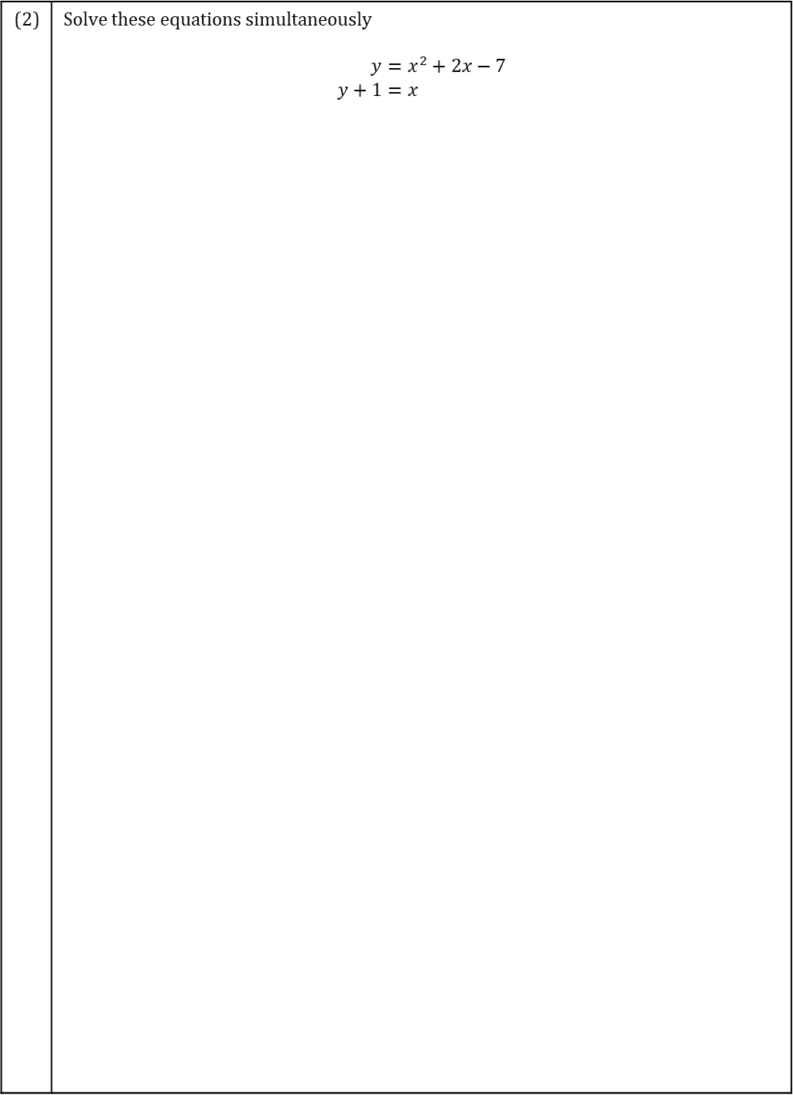
TASK
Solving simultaneous equations
Date:
(2) | Solve these equations simultaneously $$\begin{aligned}y&=x^{2}+2x−7 \\ y+1&=x\end{aligned}$$

Slide 5
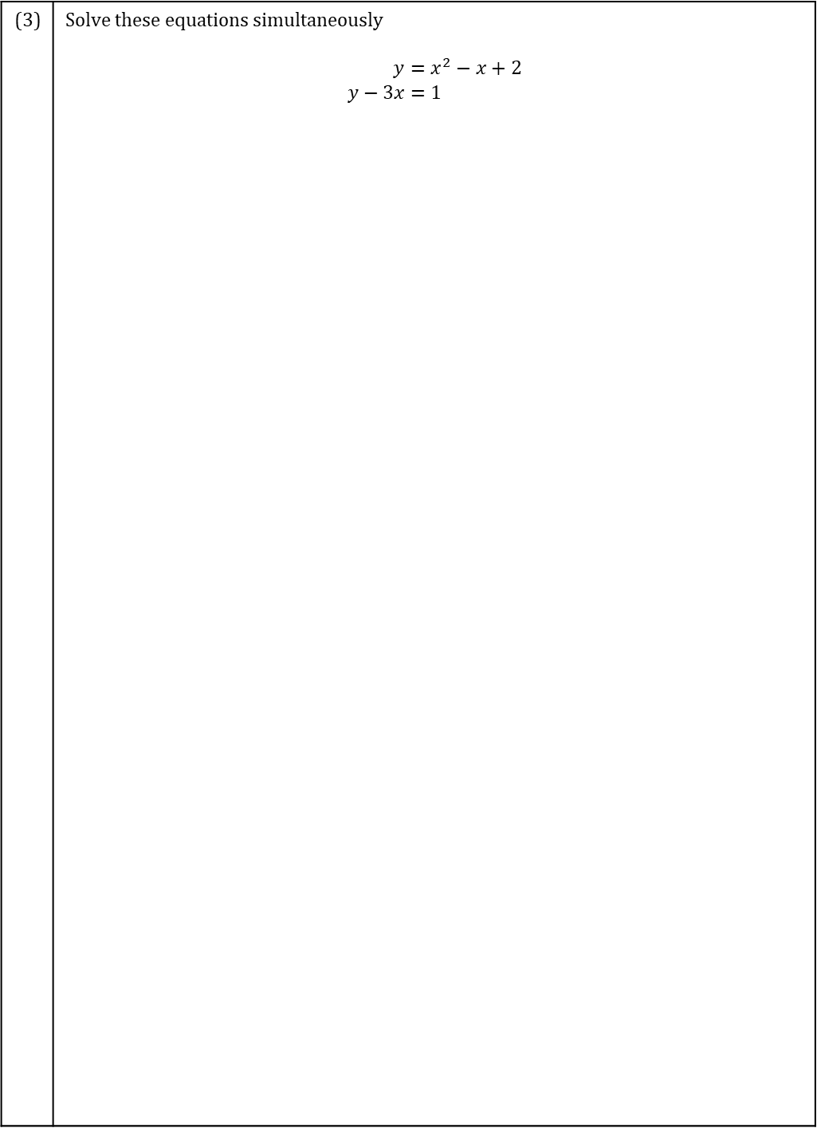
TASK
Solving simultaneous equations
Date:
(3) | Solve these equations simultaneously $$\begin{aligned}y&=x^{2}−x+2 \\ y−3x&=1\end{aligned}$$

Slide 6
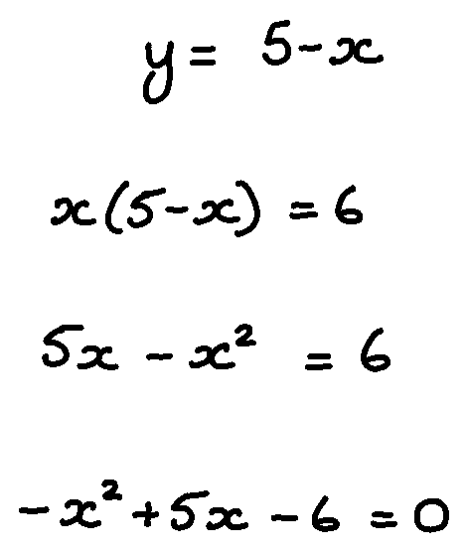
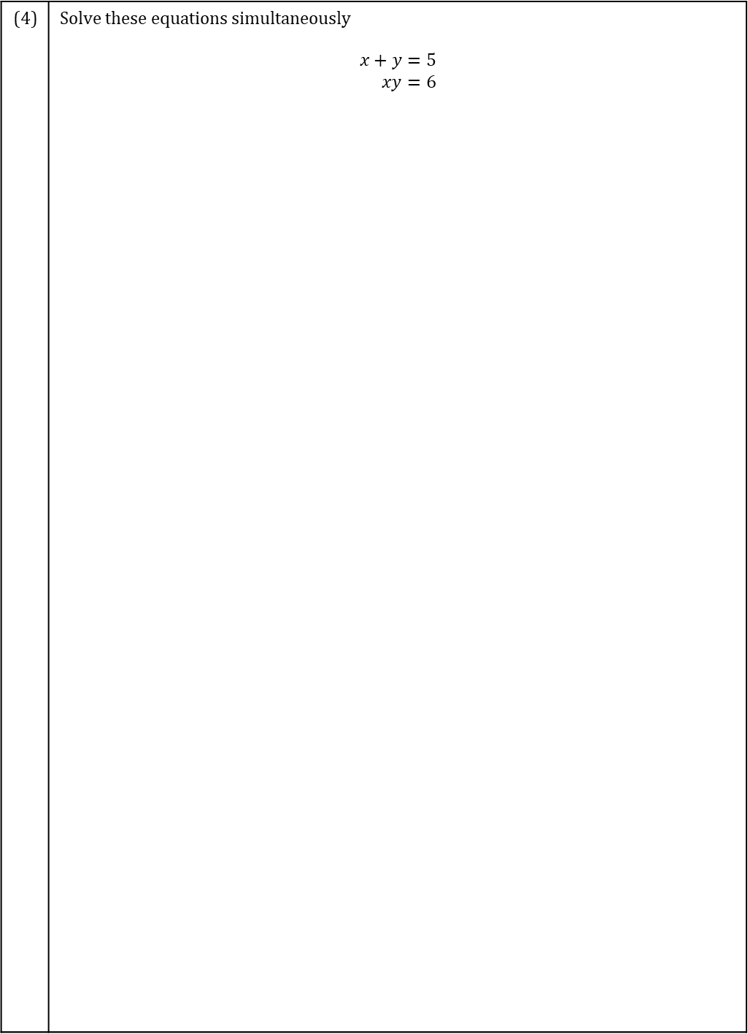
TASK
Solving simultaneous equations
Date:
(4) | Solve these equations simultaneously $$\begin{aligned}x+y&=5 \\ xy&=6\end{aligned}$$

Slide 7
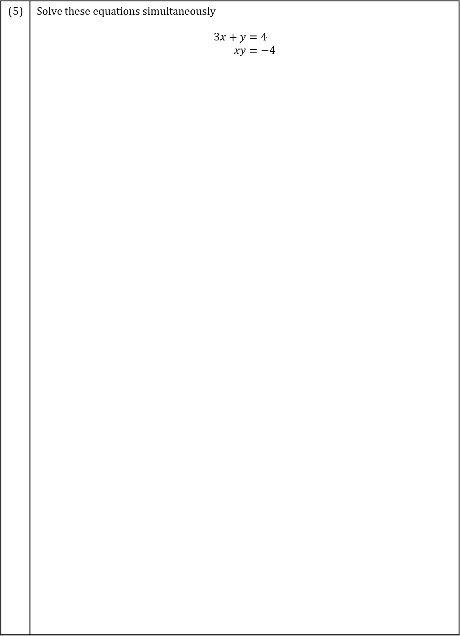
TASK
Solving simultaneous equations
Date:
(5) | Solve these equations simultaneously $$\begin{aligned}3x+y&=4 \\ xy&=−4\end{aligned}$$

Slide 8
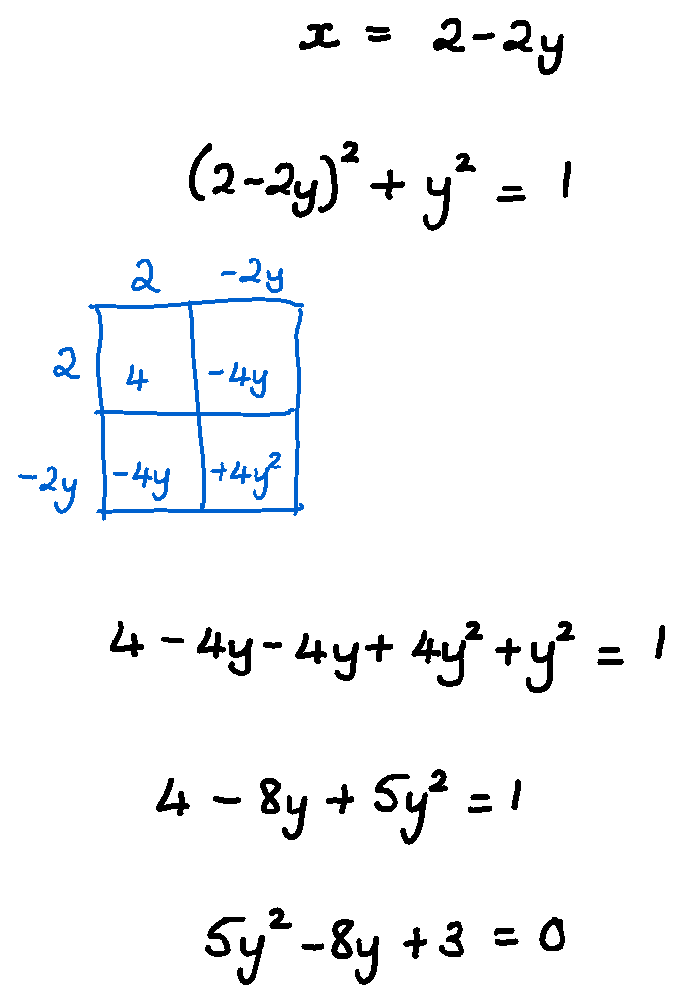
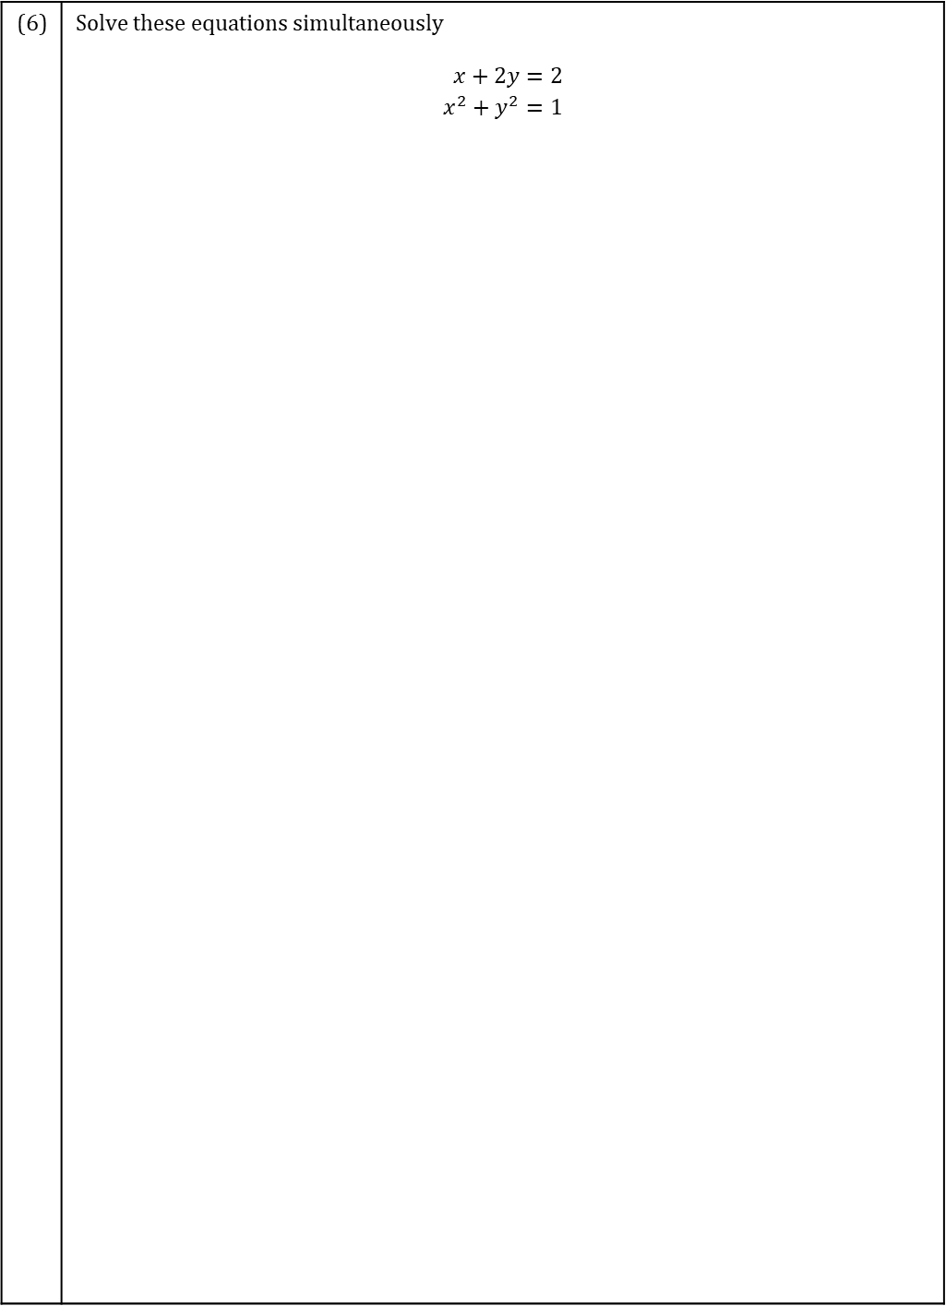
TASK
Solving simultaneous equations
Date:
(6) | Solve these equations simultaneously $$\begin{aligned}x+2y&=2 \\ x^{2}+y^{2}&=1\end{aligned}$$

Slide 9
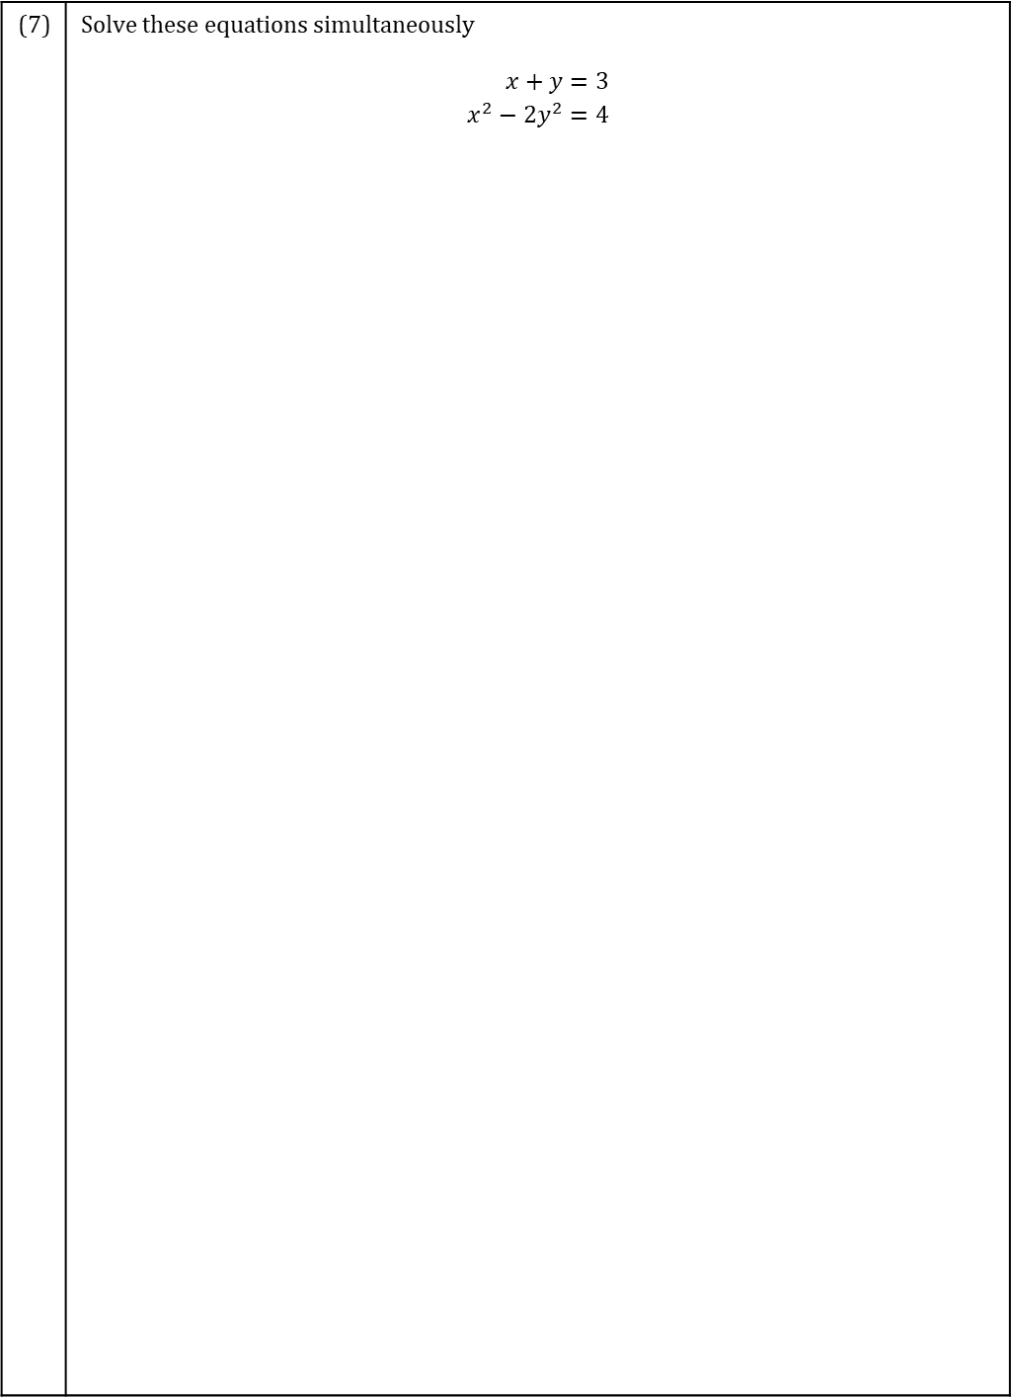
TASK
Solving simultaneous equations
Date:
(7) | Solve these equations simultaneously $$\begin{aligned}x+y&=3 \\ x^{2}−2y^{2}&=4\end{aligned}$$

