Slide 1


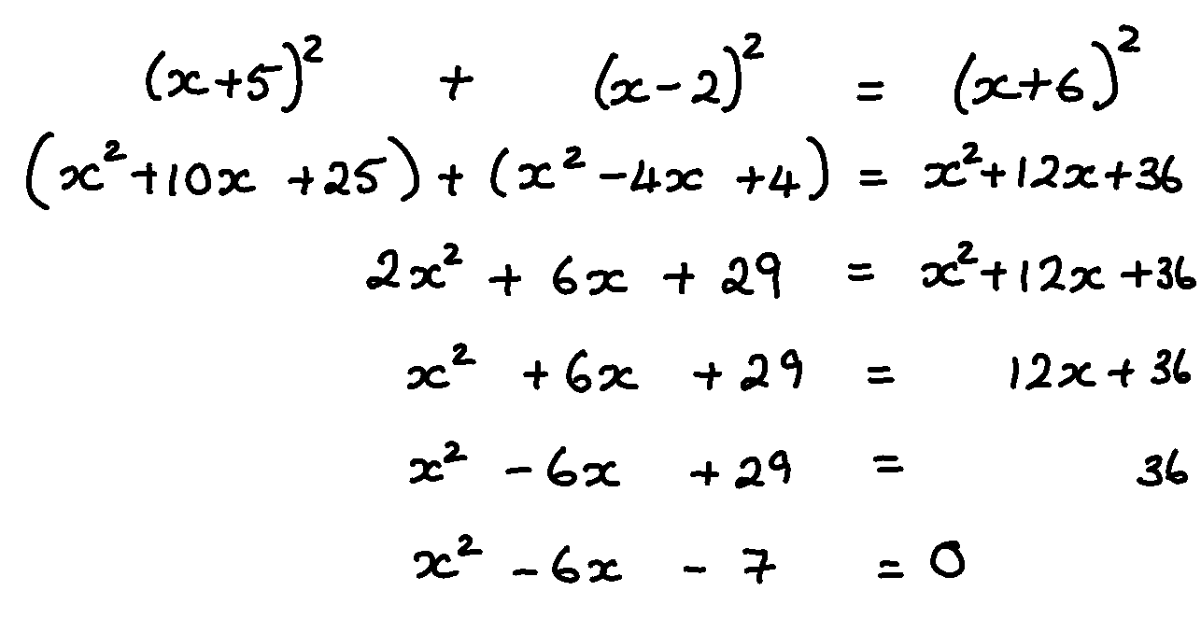

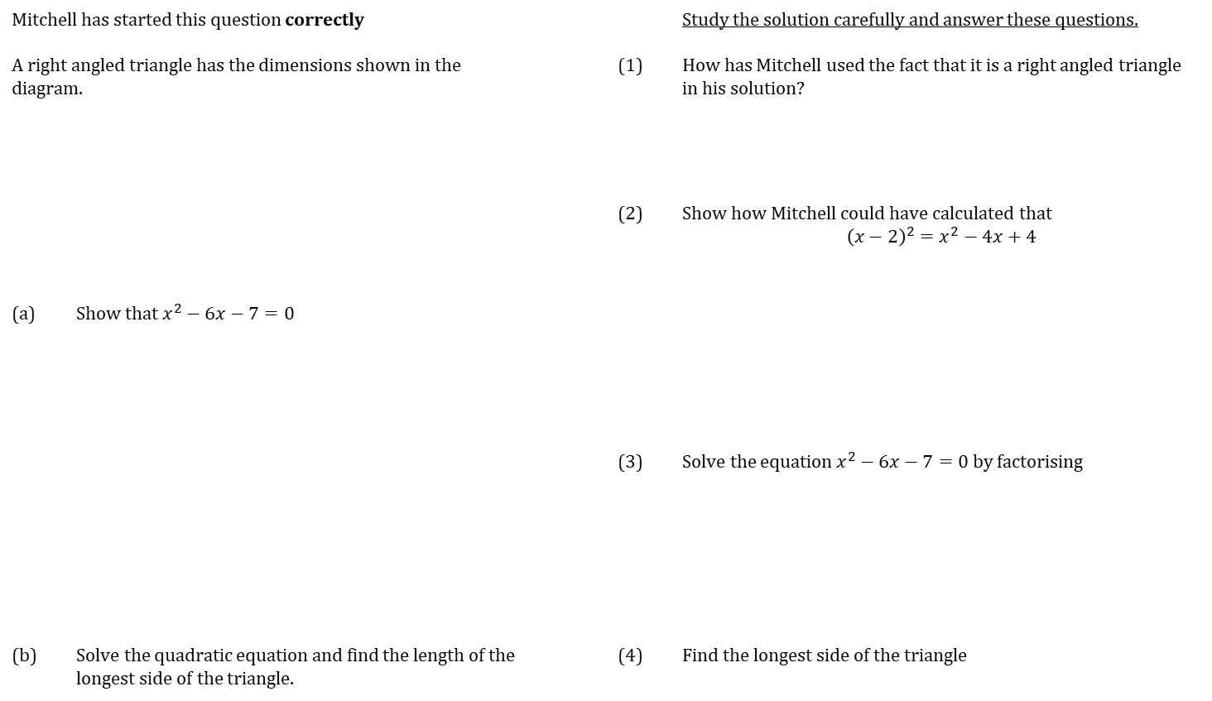


WORKED EXAMPLE
SET UP AND SOLVE QUADRATICS
Mitchell has started this question correctly |  |  |  | Study the solution carefully and answer these questions.
A right angled triangle has the dimensions shown in the diagram. | A right angled triangle has the dimensions shown in the diagram. |  | (1) | How has Mitchell used the fact that it is a right angled triangle in his solution?
 |  |  | (2) | Show how Mitchell could have calculated that $${\left(x−2\right)}^{2}=x^{2}−4x+4$$
(a) | Show that $x^{2}−6x−7=0$
 |  |  | (3) | Solve the equation $x^{2}−6x−7=0$ by factorising
(b) | Solve the quadratic equation and find the length of the longest side of the triangle. |  | (4) | Find the longest side of the triangle
$$\left(x+6\right)\text{cm}$$
$$\left(x−2\right)\text{cm}$$
$$\left(x+5\right)\text{cm}$$

Slide 2
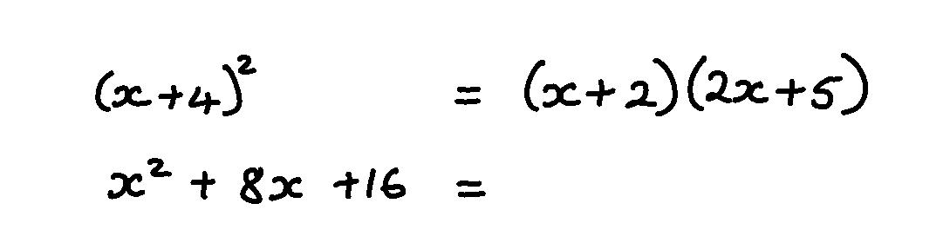

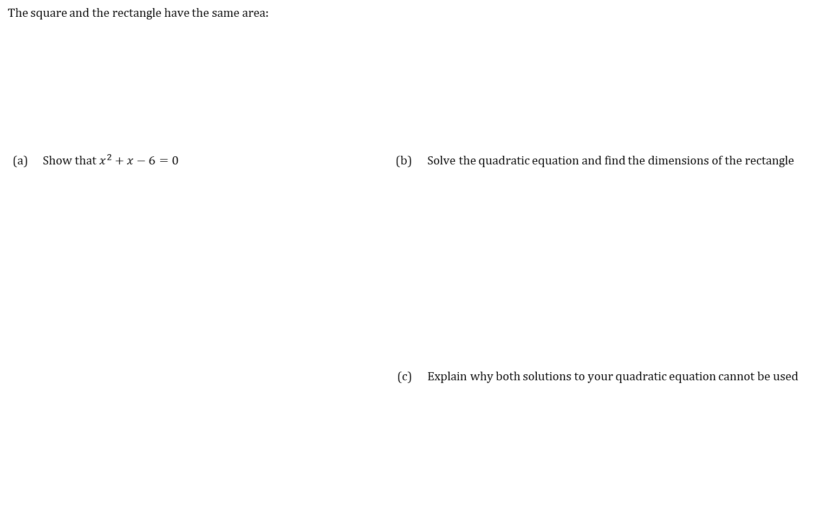


COMPLETE THE QUESTION
SET UP AND SOLVE QUADRATICS
The square and the rectangle have the same area: | A right angled triangle has the dimensions shown in the diagram.
(a) | Show that $x^{2}+x−6=0$ | (b) | Solve the quadratic equation and find the dimensions of the rectangle
 |  | (c) | Explain why both solutions to your quadratic equation cannot be used
$(x+4)$ cm
$(2x+5)$ cm
$(x+2)$ cm

Slide 3
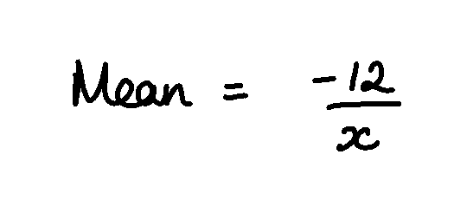
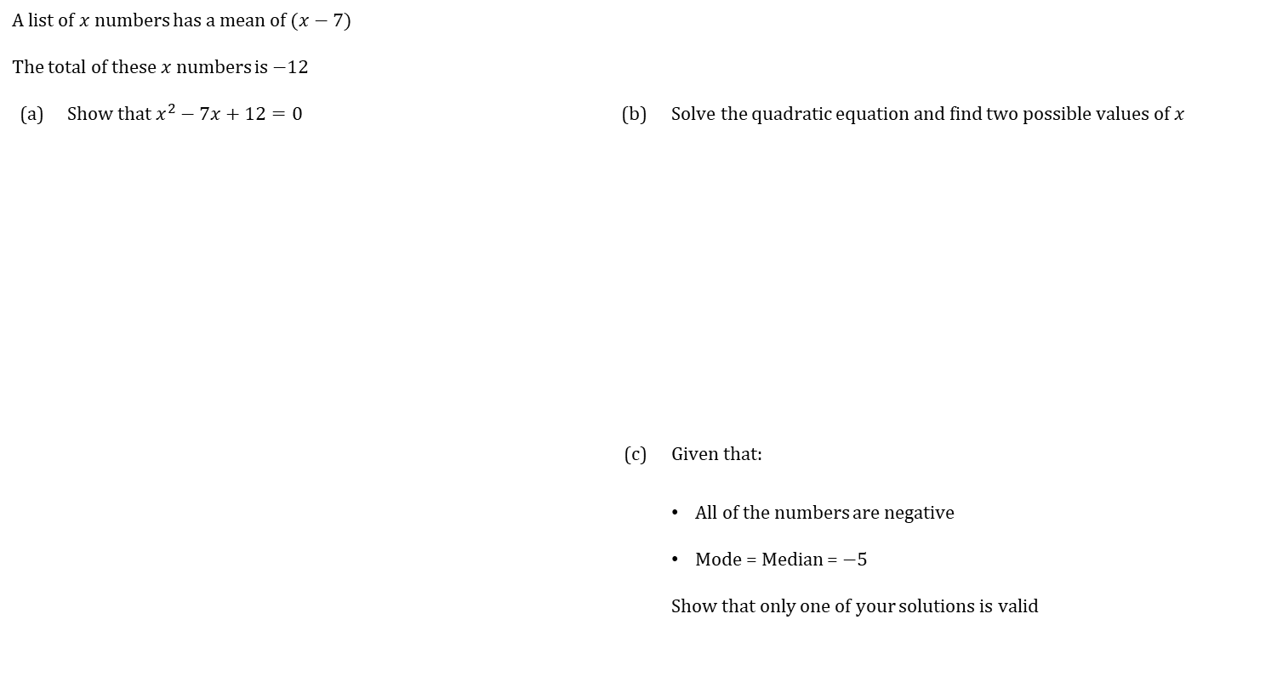
COMPLETE THE QUESTION
SET UP AND SOLVE QUADRATICS
A list of $x$ numbers has a mean of $(x−7)$ | A right angled triangle has the dimensions shown in the diagram.
The total of these $x$ numbers is $−12$
(a) | Show that $x^{2}−7x+12=0$ | (b) | Solve the quadratic equation and find two possible values of $x$
 |  | (c) | Given that:
 |  |  | All of the numbers are negative
 |  |  | Mode = Median = $−5$
 |  |  | Show that only one of your solutions is valid
https://ag-web.completemaths.com/files/c3a4e1d2-0dad-4a62-8775-65cbe3b22b45

Slide 4
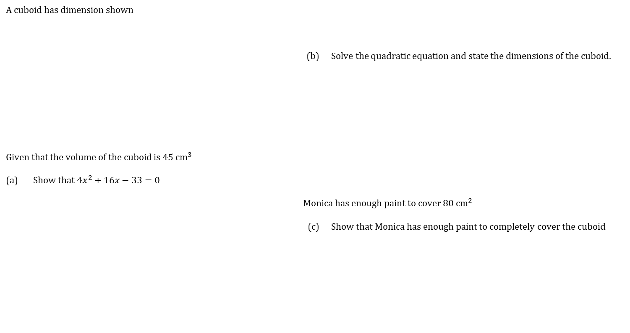



COMPLETE THE QUESTION
SET UP AND SOLVE QUADRATICS
A cuboid has dimension shown | A right angled triangle has the dimensions shown in the diagram.
 |  | (b) | Solve the quadratic equation and state the dimensions of the cuboid.
Given that the volume of the cuboid is $45 {\text{cm}}^{3}$
(a) | Show that $4x^{2}+16x−33=0$
 |  | Monica has enough paint to cover $80 {\text{cm}}^{2}$
 |  | (c) | Show that Monica has enough paint to completely cover the cuboid
$4$cm
$(x+1)$ cm
$(x+3)$ cm
https://ag-web.completemaths.com/files/c3a4e1d2-0dad-4a62-8775-65cbe3b22b45

Slide 5

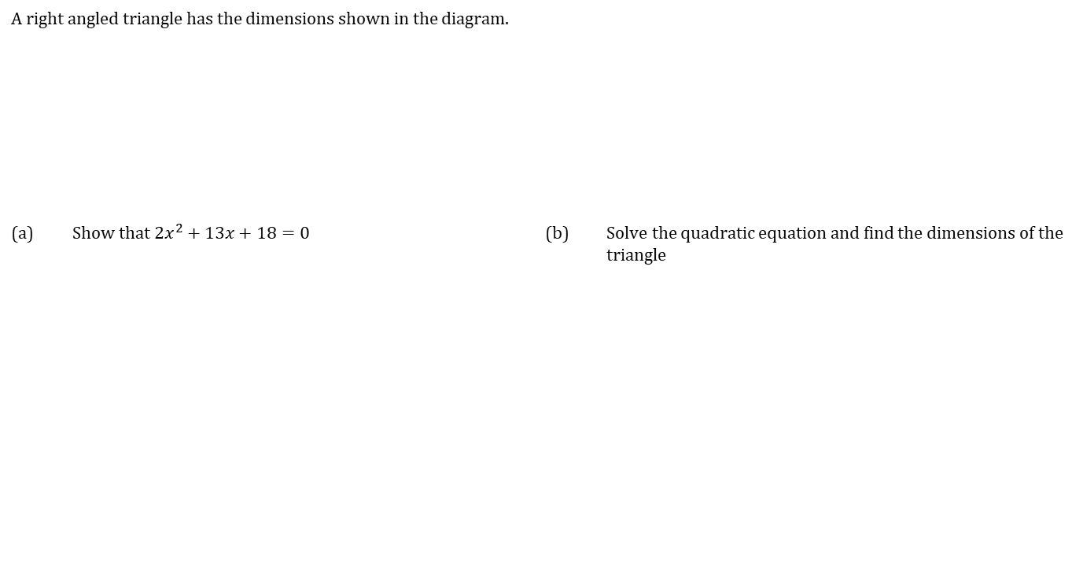


COMPLETE THE QUESTION
SET UP AND SOLVE QUADRATICS
A right angled triangle has the dimensions shown in the diagram. | A right angled triangle has the dimensions shown in the diagram.
(a) | Show that $2x^{2}+13x+18=0$ | (b) | Solve the quadratic equation and find the dimensions of the triangle
$$(3x+11\text{) }\text{cm}$$
$$\left(x+6\right)\text{cm}$$
$$\left(2x+7\right)\text{cm}$$

