Slide 1
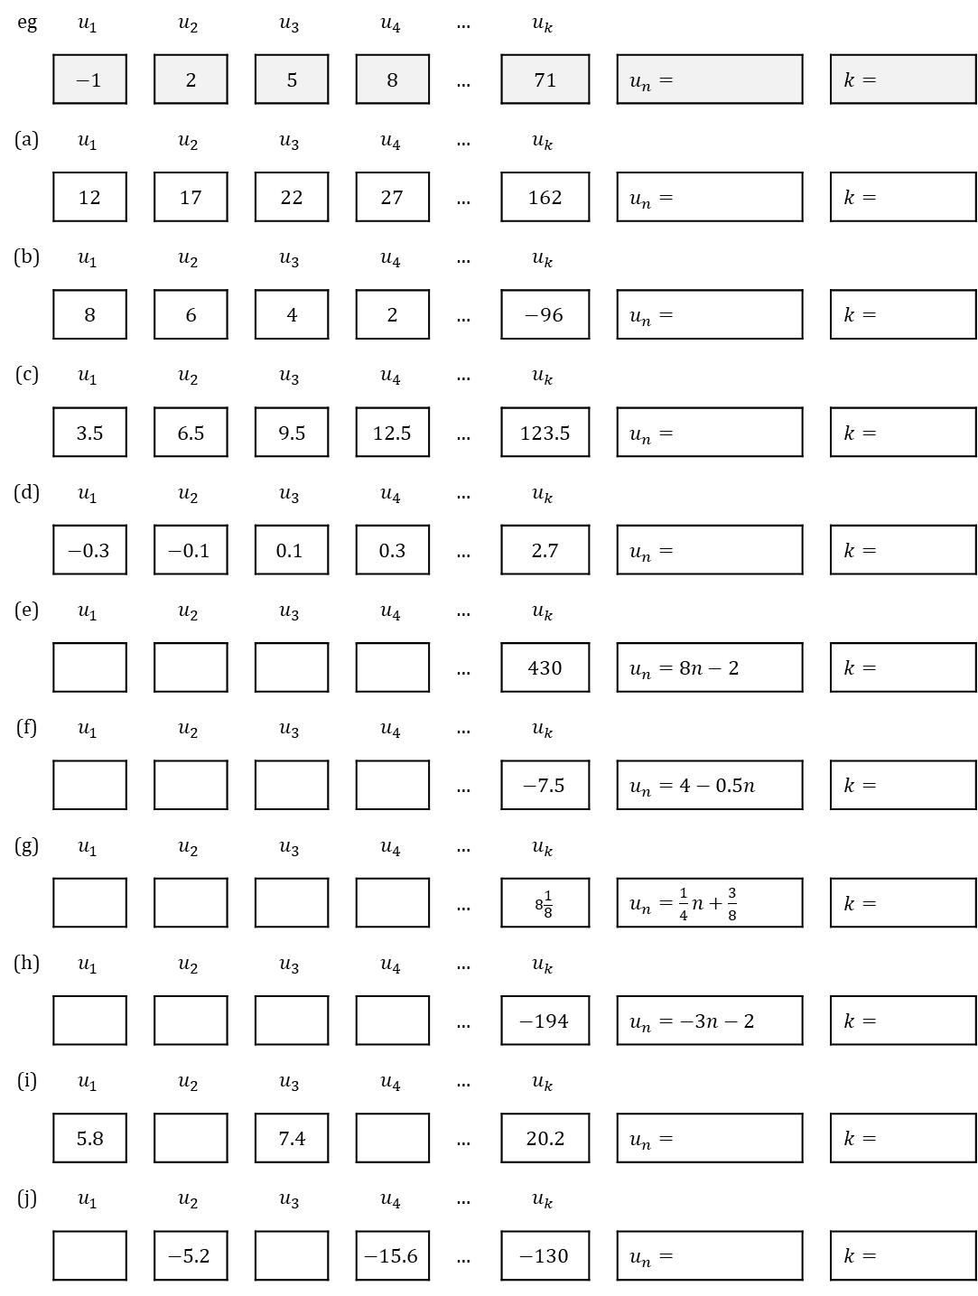
TASK
eg | $$u_{1}$$ |  | $$u_{2}$$ |  | $$u_{3}$$ |  | $$u_{4}$$ | $$…$$ | $$u_{k}$$
 | $$−1$$ |  | 2 |  | 5 |  | 8 | $$…$$ | 71 |  | $u_{n}=$ |  | $k=$
(a) | $$u_{1}$$ |  | $$u_{2}$$ |  | $$u_{3}$$ |  | $$u_{4}$$ | $$…$$ | $$u_{k}$$
 | 12 |  | 17 |  | 22 |  | 27 | $$…$$ | 162 |  | $u_{n}=$ |  | $k=$
(b) | $$u_{1}$$ |  | $$u_{2}$$ |  | $$u_{3}$$ |  | $$u_{4}$$ | $$…$$ | $$u_{k}$$
 | 8 |  | 6 |  | 4 |  | 2 | $$…$$ | $$−96$$ |  | $u_{n}=$ |  | $k=$
(c) | $$u_{1}$$ |  | $$u_{2}$$ |  | $$u_{3}$$ |  | $$u_{4}$$ | $$…$$ | $$u_{k}$$
 | 3.5 |  | 6.5 |  | 9.5 |  | 12.5 | $$…$$ | 123.5 |  | $u_{n}=$ |  | $k=$
(d) | $$u_{1}$$ |  | $$u_{2}$$ |  | $$u_{3}$$ |  | $$u_{4}$$ | $$…$$ | $$u_{k}$$
 | $$−0.3$$ |  | $$−0.1$$ |  | $$0.1$$ |  | 0.3 | $$…$$ | 2.7 |  | $u_{n}=$ |  | $k=$
(e) | $$u_{1}$$ |  | $$u_{2}$$ |  | $$u_{3}$$ |  | $$u_{4}$$ | $$…$$ | $$u_{k}$$
 |  |  |  |  |  |  |  | $$…$$ | 430 |  | $u_{n}=8n−2$ |  | $k=$
(f) | $$u_{1}$$ |  | $$u_{2}$$ |  | $$u_{3}$$ |  | $$u_{4}$$ | $$…$$ | $$u_{k}$$
 |  |  |  |  |  |  |  | $$…$$ | $$−7.5$$ |  | $u_{n}=4−0.5n$ |  | $k=$
(g) | $$u_{1}$$ |  | $$u_{2}$$ |  | $$u_{3}$$ |  | $$u_{4}$$ | $$…$$ | $$u_{k}$$
 |  |  |  |  |  |  |  | $$…$$ | $$8\frac{1}{8}$$ |  | $u_{n}=\frac{1}{4}n+\frac{3}{8}$ |  | $k=$
(h) | $$u_{1}$$ |  | $$u_{2}$$ |  | $$u_{3}$$ |  | $$u_{4}$$ | $$…$$ | $$u_{k}$$
 |  |  |  |  |  |  |  | $$…$$ | $$−194$$ |  | $u_{n}=−3n−2$ |  | $k=$
(i) | $$u_{1}$$ |  | $$u_{2}$$ |  | $$u_{3}$$ |  | $$u_{4}$$ | $$…$$ | $$u_{k}$$
 | 5.8 |  |  |  | 7.4 |  |  | $$…$$ | 20.2 |  | $u_{n}=$ |  | $k=$
(j) | $$u_{1}$$ |  | $$u_{2}$$ |  | $$u_{3}$$ |  | $$u_{4}$$ | $$…$$ | $$u_{k}$$
 |  |  | $$−5.2$$ |  |  |  | $$−15.6$$ | $$…$$ | $$−130$$ |  | $u_{n}=$ |  | $k=$

