Slide 1
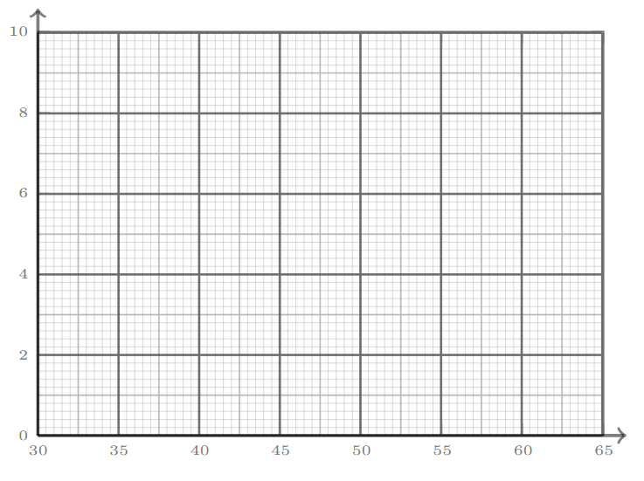
TASK
Histograms
Erin has collected the following data about 63 members of her local running club and printed off the frequency table and histogram.
The printer is running out of ink – so it hasn’t printed clearly
Complete the table and the histogram for Erin.
PB for 10 km (minutes) | Frequency
$$34≤t<40$$ | 9
$$40≤t<42$$ | 5
$$42≤t<44$$ | 15
$$44≤t<48$$ | 12
$$48≤t<54$$ | 12
$$54≤t≤64$$ | 10
 |  |  |  |  |  | 2

Slide 2
TASK
Erin has collected the following data about 63 members of her local running club and printed off the frequency table and histogram.
The printer is running out of ink – so it hasn’t printed clearly
Complete the table and the histogram for Erin.
PB for 10 km (minutes) | Frequency
$$34≤t<40$$ | 9
$$40≤t<42$$ | 5
$$42≤t<44$$ | 15
$$44≤t<48$$ | 12
$$48≤t<54$$ | 12
$$54≤t≤64$$ | 10
 |  |  |  |  |  | 2

