Slide 1
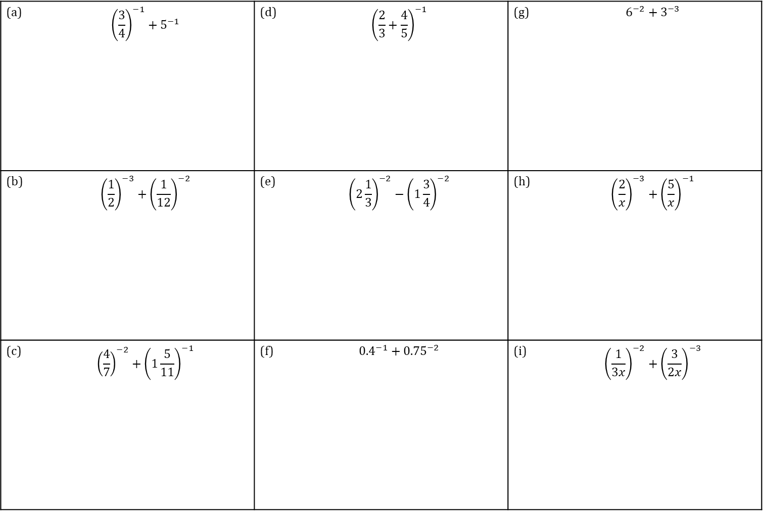
TASK
Evaluate:
Calculations with Negative Indices
(a) | $${\left(\frac{3}{4}\right)}^{−1}+5^{−1}$$ | (d) | $${\left(\frac{2}{3}+\frac{4}{5}\right)}^{−1}$$ | (g) | $$6^{−2}+3^{−3}$$
(b) | $${\left(\frac{1}{2}\right)}^{−3}+{\left(\frac{1}{12}\right)}^{−2}$$ | (e) | $${\left(2\frac{1}{3}\right)}^{−2}−{\left(1\frac{3}{4}\right)}^{−2}$$ | (h) | $${\left(\frac{2}{x}\right)}^{−3}+{\left(\frac{5}{x}\right)}^{−1}$$
(c) | $${\left(\frac{4}{7}\right)}^{−2}+{\left(1\frac{5}{11}\right)}^{−1}$$ | (f) | $${0.4}^{−1}+{0.75}^{−2}$$ | (i) | $${\left(\frac{1}{3x}\right)}^{−2}+{\left(\frac{3}{2x}\right)}^{−3}$$
https://ag-web.completemaths.com/files/c3a4e1d2-0dad-4a62-8775-65cbe3b22b45

Slide 2
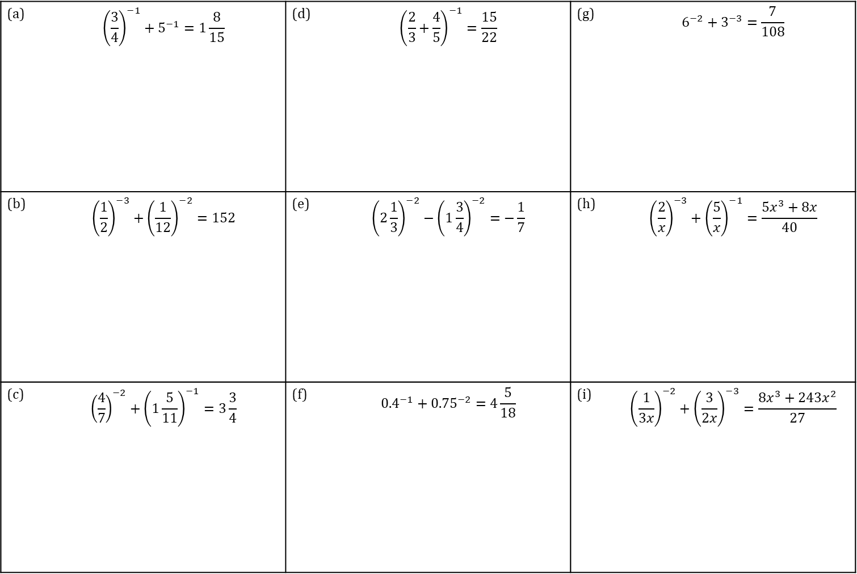
TASK
Show that
Calculations with Negative Indices
(a) | $${\left(\frac{3}{4}\right)}^{−1}+5^{−1}=1\frac{8}{15}$$ | (d) | $${\left(\frac{2}{3}+\frac{4}{5}\right)}^{−1}=\frac{15}{22}$$ | (g) | $$6^{−2}+3^{−3}=\frac{7}{108}$$
(b) | $${\left(\frac{1}{2}\right)}^{−3}+{\left(\frac{1}{12}\right)}^{−2}=152$$ | (e) | $${\left(2\frac{1}{3}\right)}^{−2}−{\left(1\frac{3}{4}\right)}^{−2}=−\frac{1}{7}$$ | (h) | $${\left(\frac{2}{x}\right)}^{−3}+{\left(\frac{5}{x}\right)}^{−1}=\frac{5x^{3}+8x}{40}$$
(c) | $${\left(\frac{4}{7}\right)}^{−2}+{\left(1\frac{5}{11}\right)}^{−1}=3\frac{3}{4}$$ | (f) | $${0.4}^{−1}+{0.75}^{−2}=4\frac{5}{18}$$ | (i) | $${\left(\frac{1}{3x}\right)}^{−2}+{\left(\frac{3}{2x}\right)}^{−3}=\frac{8x^{3}+243x^{2}}{27}$$
https://ag-web.completemaths.com/files/c3a4e1d2-0dad-4a62-8775-65cbe3b22b45

Slide 3
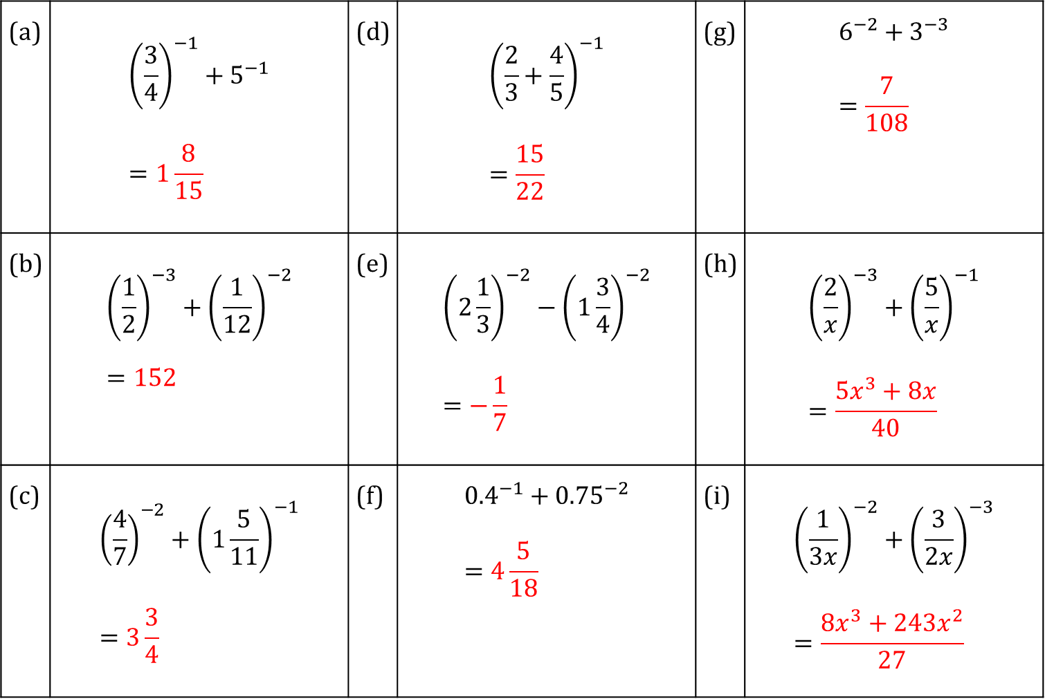
TASK
SOLUTIONS
Calculations with Negative Indices
(a) | $${\left(\frac{3}{4}\right)}^{−1}+5^{−1} \\ =1\frac{8}{15}$$ | (d) | $${\left(\frac{2}{3}+\frac{4}{5}\right)}^{−1} \\ =\frac{15}{22}$$ | (g) | $$6^{−2}+3^{−3} \\ =\frac{7}{108}$$
(b) | $${\left(\frac{1}{2}\right)}^{−3}+{\left(\frac{1}{12}\right)}^{−2} \\ =152$$ | (e) | $${\left(2\frac{1}{3}\right)}^{−2}−{\left(1\frac{3}{4}\right)}^{−2} \\ =−\frac{1}{7}$$ | (h) | $${\left(\frac{2}{x}\right)}^{−3}+{\left(\frac{5}{x}\right)}^{−1} \\ =\frac{5x^{3}+8x}{40}$$
(c) | $${\left(\frac{4}{7}\right)}^{−2}+{\left(1\frac{5}{11}\right)}^{−1} \\ =3\frac{3}{4}$$ | (f) | $${0.4}^{−1}+{0.75}^{−2} \\ =4\frac{5}{18}$$ | (i) | $${\left(\frac{1}{3x}\right)}^{−2}+{\left(\frac{3}{2x}\right)}^{−3} \\ =\frac{8x^{3}+243x^{2}}{27}$$
https://ag-web.completemaths.com/files/c3a4e1d2-0dad-4a62-8775-65cbe3b22b45

