Slide 1
TASK
List all the factors of 1944.
You may leave your answers as a product of primes

Slide 2
TASK
Find the prime factor decomposition of the following numbers, and identify how many factors they have.
You DO NOT have to list all the factors if you can explain how you answered the question without doing so.
8
9
10
11
12
13
14
15
16
17
18
19
20
30
32
48
64
120
150
1000
4000
159000

Slide 3
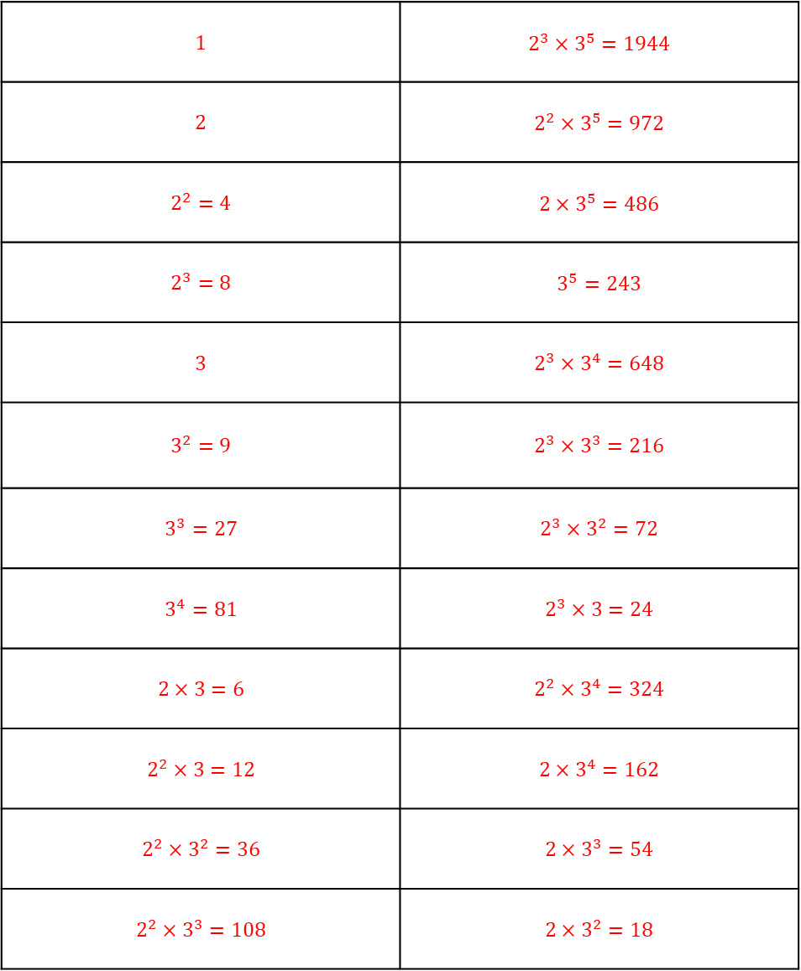
TASK
ANSWERS
List all the factors of 1944.
You may leave your answers as a product of primes
$$1$$ | $$2^{3}×3^{5}=1944$$
$$2$$ | $$2^{2}×3^{5}=972$$
$$2^{2}=4$$ | $$2×3^{5}=486$$
$$2^{3}=8$$ | $$3^{5}=243$$
$$3$$ | $$2^{3}×3^{4}=648$$
$$3^{2}=9$$ | $$2^{3}×3^{3}=216$$
$$3^{3}=27$$ | $$2^{3}×3^{2}=72$$
$$3^{4}=81$$ | $$2^{3}×3=24$$
$$2×3=6$$ | $$2^{2}×3^{4}=324$$
$$2^{2}×3=12$$ | $$2×3^{4}=162$$
$$2^{2}×3^{2}=36$$ | $$2×3^{3}=54$$
$$2^{2}×3^{3}=108$$ | $$2×3^{2}=18$$

Slide 4
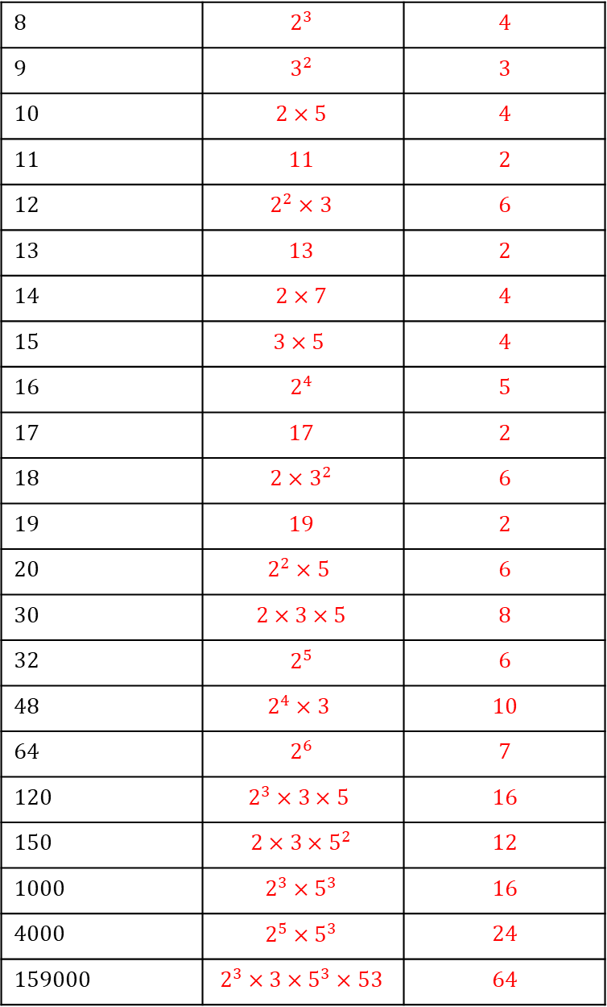
TASK
ANSWERS
Find the prime factor decomposition of the following numbers, and identify how many factors they have.
You DO NOT have to list all the factors if you can explain how you answered the question without doing so.
8 | $$2^{3}$$ | 4
9 | $$3^{2}$$ | 3
10 | $$2×5$$ | 4
11 | $$11$$ | 2
12 | $$2^{2}×3$$ | 6
13 | $$13$$ | 2
14 | $$2×7$$ | 4
15 | $$3×5$$ | 4
16 | $$2^{4}$$ | 5
17 | $$17$$ | 2
18 | $$2×3^{2}$$ | 6
19 | $$19$$ | 2
20 | $$2^{2}×5$$ | 6
30 | $$2×3×5$$ | 8
32 | $$2^{5}$$ | 6
48 | $$2^{4}×3$$ | 10
64 | $$2^{6}$$ | 7
120 | $$2^{3}×3×5$$ | 16
150 | $$2×3×5^{2}$$ | 12
1000 | $$2^{3}×5^{3}$$ | 16
4000 | $$2^{5}×5^{3}$$ | 24
159000 | $$2^{3}×3×5^{3}×53$$ | 64

