Slide 1
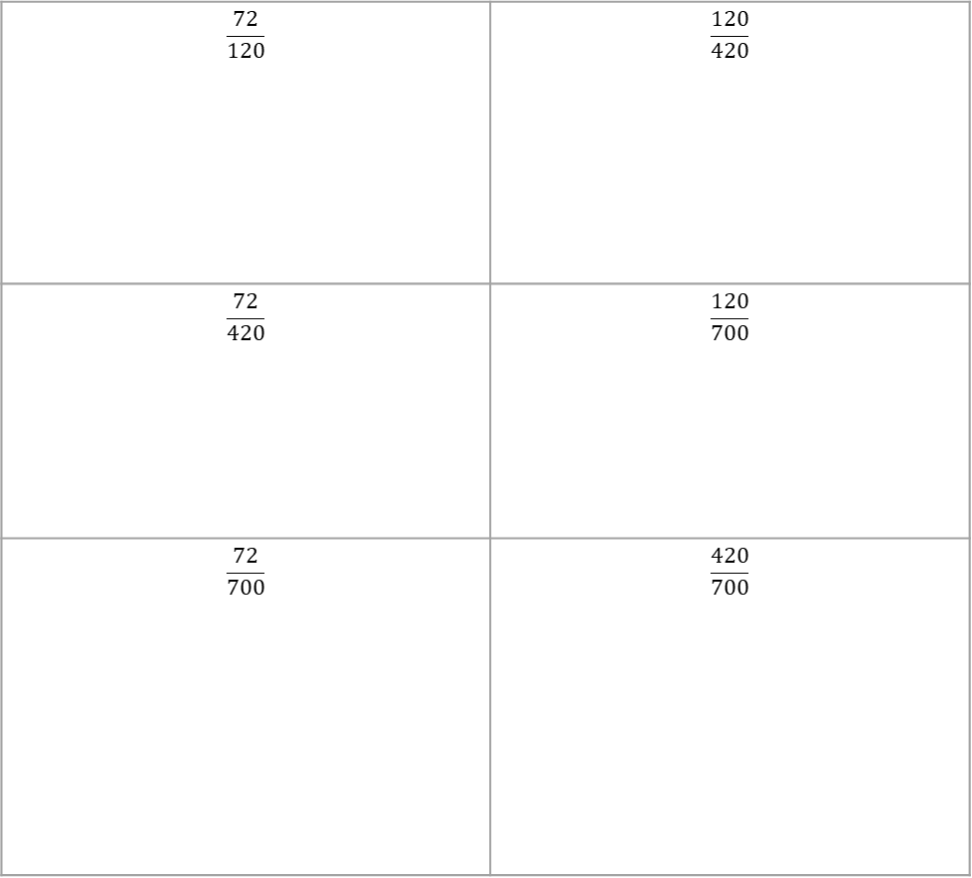
Find the prime factor decomposition of:
72 | 120 | 420 | 700
Hence fully simplify:
$$\frac{72}{120}$$ | $$\frac{120}{420}$$
$$\frac{72}{420}$$ | $$\frac{120}{700}$$
$$\frac{72}{700}$$ | $$\frac{420}{700}$$

